Slide 1
Mini Project
stl_props: An octave program to extract properties(volume and area) from a cad model in stl file format.

Slide 2
What is STL file format?
STL format is the most commonly used format file for 3D printing.
STL stands for Standard Tessellation Language.
STL file is widely used because it is simple, light and easy to be handled by 3D machines and software.
STL files look like <filename>.stl, i.e. ends with “.stl”.

Slide 3
Types of STL
ASCII: It is human readable, has large file size and requires more processing to be read by computer.
Binary: It is non-readable by human, has small file size, and requires less processing to be read by computers.

Slide 4
This project supports binary only.
This project supports binary stl file format only. The decision was made keeping in mind that binary format is more efficient and easy to work on. To support ASCII, ultimately even ascii file format is first converted to binary and then the operations are performed.

Slide 5
What is inside a .stl file.
An stl file contains just a bunch of triangles in 3d space which connect together to form a solid surface.
Each of those triangles are defined by the coordinates of their three vertices i.e.
(v1x, v1y, v1z)
(v2x, v2y, v2z)
(v3x, v3y, v3z)
And a normal
(nx, ny, nz)
Normal can also be calculated using the order in which the vertices are given by applying the right hand rule.
Header: It is the first line and contains the title of the file.
No. of triangles: This is the second line.

Slide 6
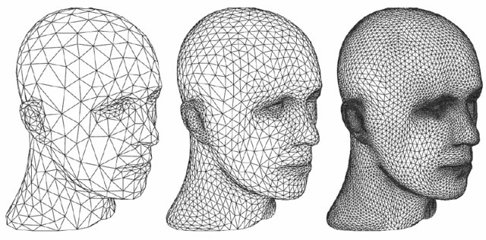
Looks something like this when viewed in a supported program.
Notice as more and more tringles are used then model becomes more finer.

Slide 7
To be more specific
UINT8[80] – Header - 80 bytes
UINT32 – Number of triangles - 4 bytes
foreach triangle - 50 bytes:
REAL32[3] – Normal vector - 12 bytes
REAL32[3] – Vertex 1 - 12 bytes
REAL32[3] – Vertex 2 - 12 bytes
REAL32[3] – Vertex 3 - 12 bytes
UINT16 – Attribute byte count - 2 bytes
end

Slide 8

Calculating area
As we know the solid is made up of just a bunch of connected triangles.
Area of each individual triangle can be calculated and then be added up to get area of the solid.
The formula for calculating the area of a triangle given its coordinates in 3d space is

Slide 9
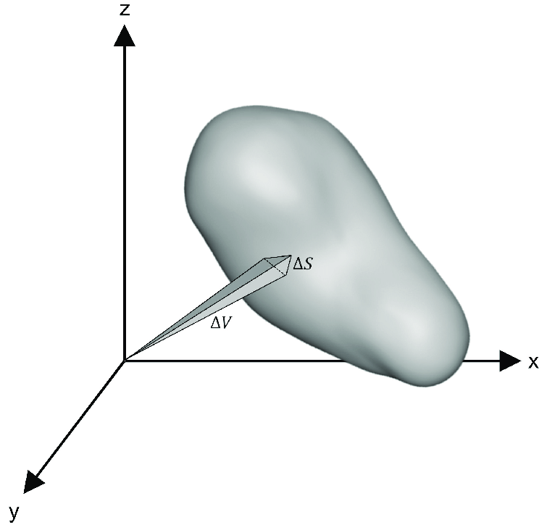
Calculating volume
Similarly for volume, imagine each triangle to be base of a tetrahedron an apex of whose coincides with the origin. A tetrahedron is a solid with 4 vertices.

Slide 10

Calculating volume
Notice if we take signed volume of each of those tetrahedron, we get resultant volume of the whole solid.
The formula for volume of a tetrahedron whose apex coincides with origin is
Where a, b and c are coordinates of vertices of the base(a triangle).

Slide 11

Usage and working of program (guide)
Using the program is simple
Open octave
Make sure stl file is in binary format, and in stl_files directory.
In command window type: stl_props <filename>.stl
slt_props is the name of the program
filename is the name of the stl file whose properties are to be extracted.

Slide 12
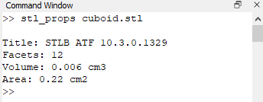
Usage and working of program (guide)
The output should look something like this
Notice the units are in cm for both area and volume. stl file has actually no units information contained in them.
The program is made to do this on purpose.
Reason being almost all cad programs converts the respective units of the model to cm before exporting to stl.
This is convenient because most 3d printers have working dimensions in scale of cms.

Slide 13
Refrences
http://chenlab.ece.cornell.edu/Publication/Cha/icip01_Cha.pdf
https://en.wikipedia.org/wiki/Tetrahedron#Volume
https://en.wikipedia.org/wiki/Triangle#Using_coordinates
https://en.wikipedia.org/wiki/STL_(file_format)#Binary_STL

